Slide 1

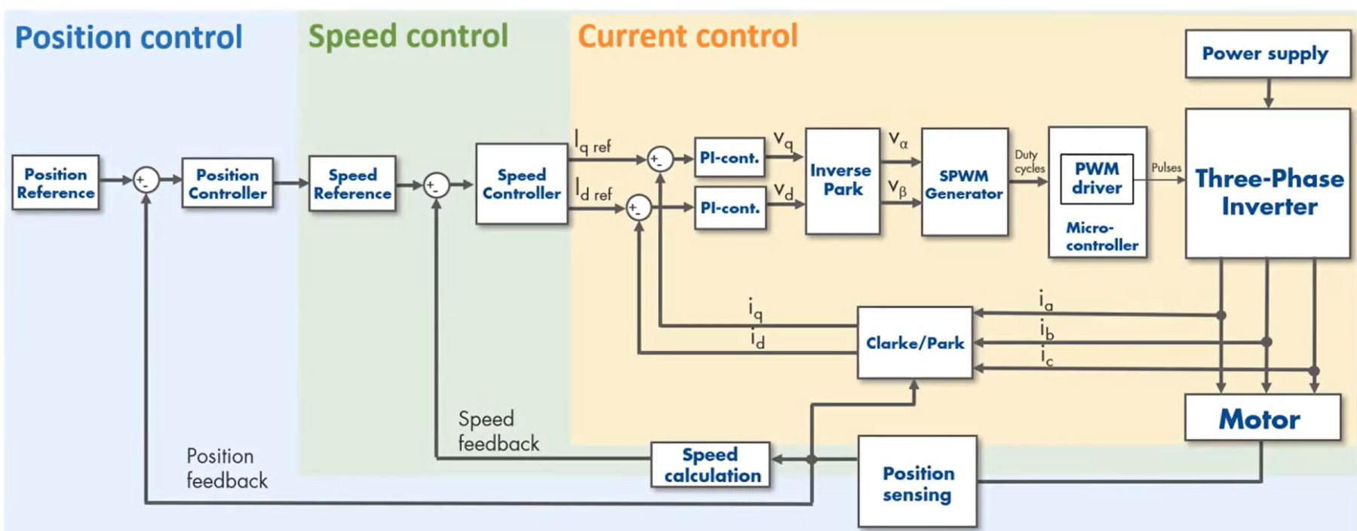
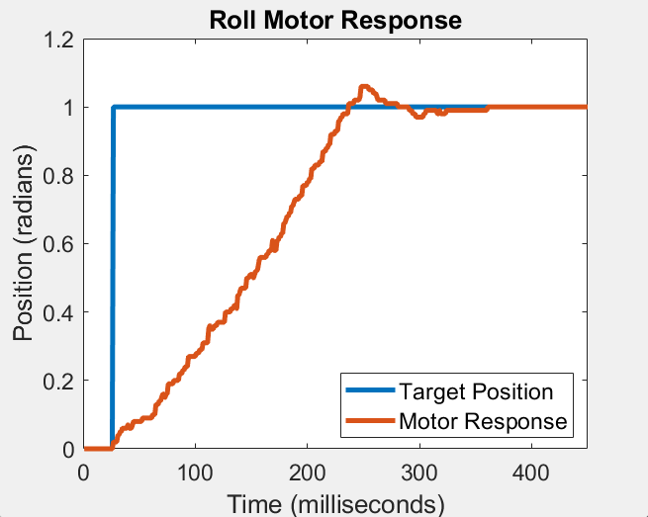
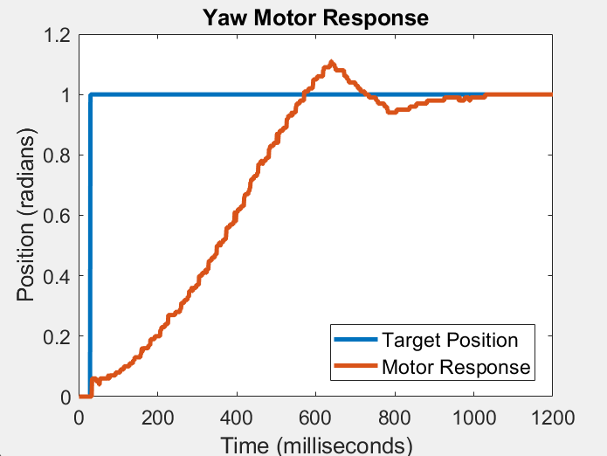
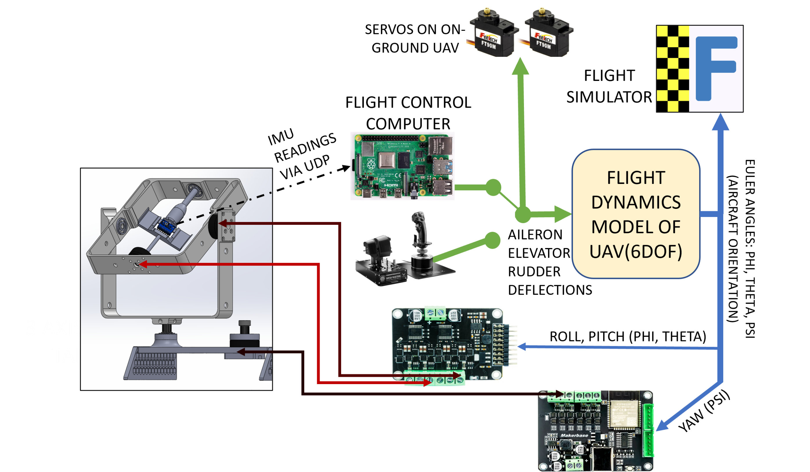
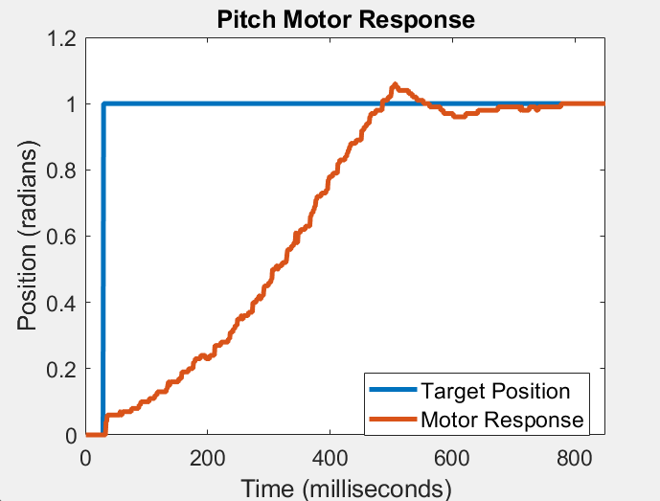
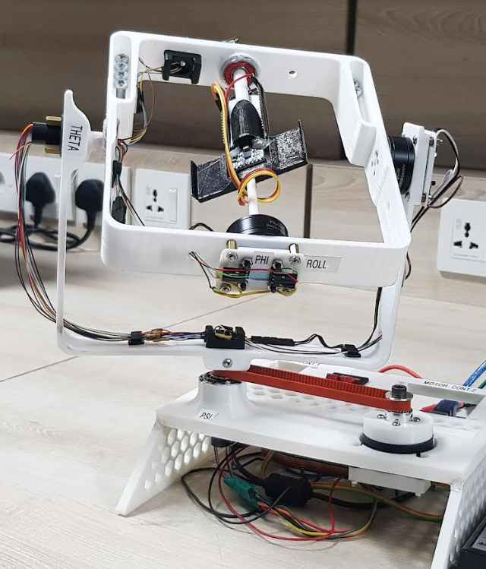
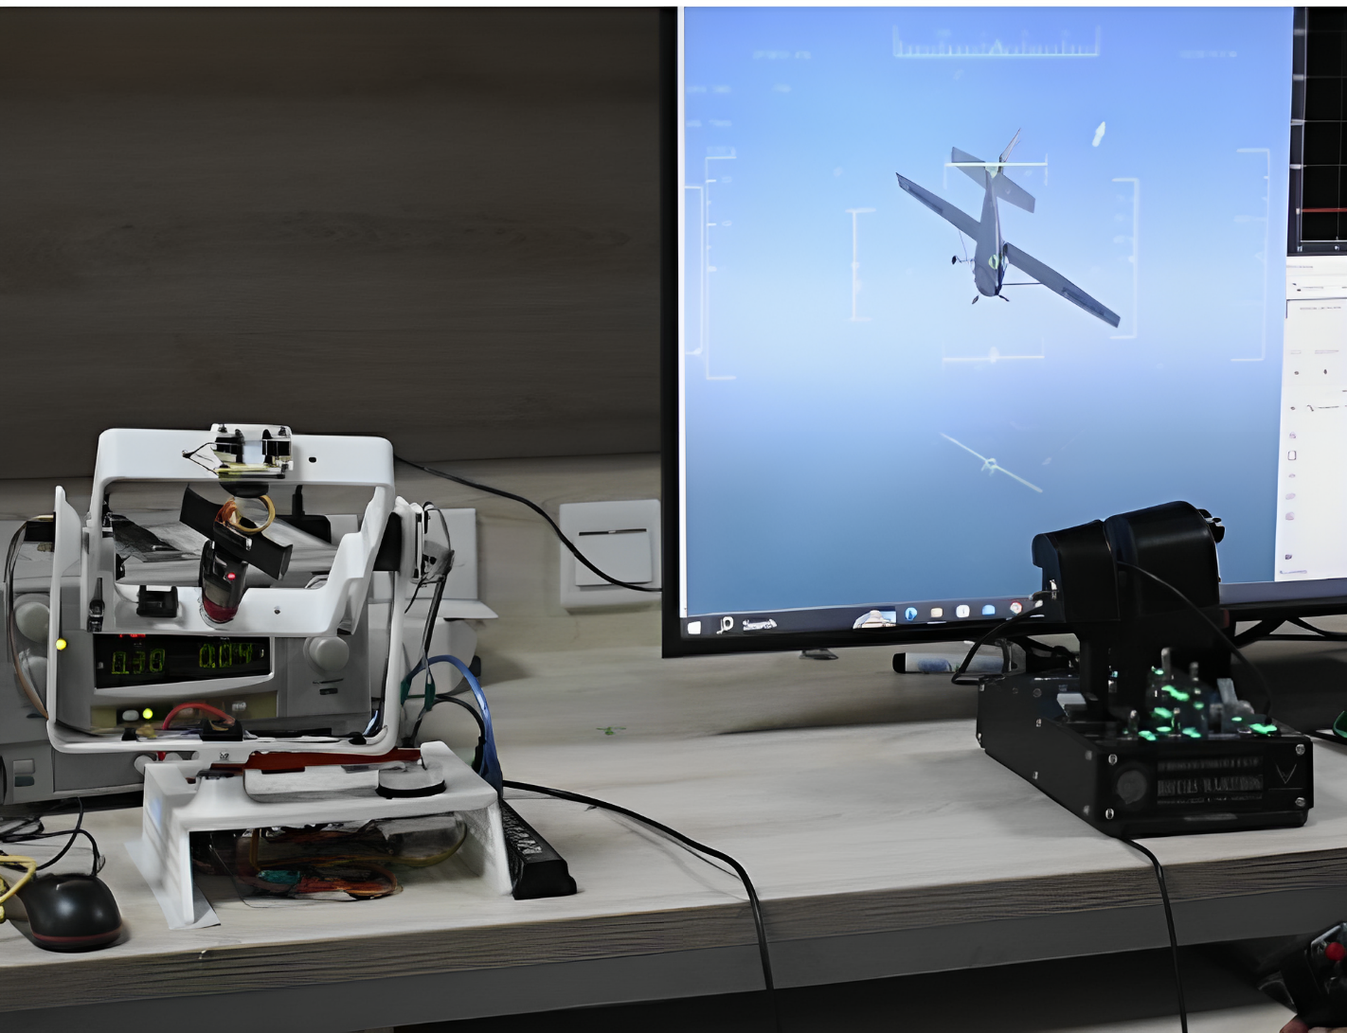
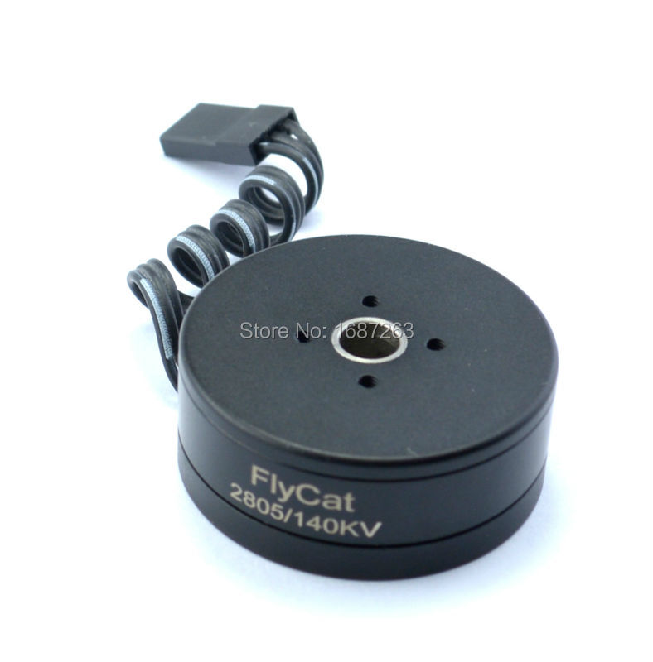
MODELLING, SIMULATION, AND CONTROL DESIGN OF A 3-DOF MOTION SIMULATOR
Avn Cdt Ashal Akhtar
Asst Prof Dr Taimoor & Sqn Ldr Jehanzaib
MOTIVATION
MOTOR CONTROL
To build a 3-axis motion simulator facilitating low-risk, cost-effective Hardware in Loop Simulation of Flight Control Computers (FCC).
Indigenous development of motion simulator
Cost-efficient testing of Guidance Systems, INS, MEMS based sensors, and other modules
Advancement in autonomous UAV technology specific to Kamikaze Drones
SCOPE
Implementation of Field Oriented Positional Control
Capability for continuous 360-degree rotation
Validation of Flight Control Computer (Raspberry Pi) through Hardware-in-Loop Simulation (HILS)
Motor Position Control through Field Oriented Control.
RESULTS
METHODOLOGY
Positional Accuracy | ±0.17 degrees
Rotational Rates | Roll: 1200 deg/sec Pitch: 900 deg/sec Yaw : 600 deg/sec
Real-Time Motion Control through Simulink
HARDWARE
Gimbal BLDC Motors
Position Sensor
Slip Rings
Motor Drivers
APPLICATIONS
Validation of Flight Control Computers and Flight Dynamic Models
Testing of Guidance Systems and Gyro sensors
Aircraft IMU Calibration
FUTURE WORK
Robust Design for heavier Payloads
Design as Lab Equipment
Use of Industrial Parts

